Slide 1
Data Mining ~ ~ Meet 02 ~ ~ Program Studi Sains Data Universitas Teknologi Yogyakarta
Dr. Donny Avianto, S.T., M.T.

Slide 2

Why Mine Data? Commercial Viewpoint
Lots of data is being collected and warehoused
Web data, e-commerce
purchases at department/ grocery stores
Bank/Credit Card transactions
Computers have become cheaper and more powerful
Competitive Pressure is Strong
Provide better, customized services for an edge (e.g. in Customer Relationship Management)

Slide 3
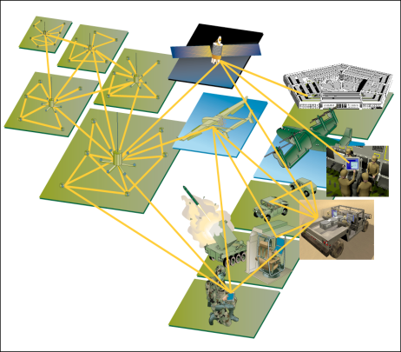
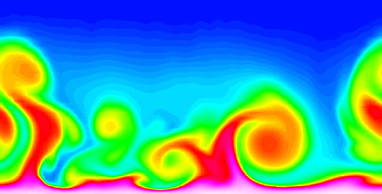
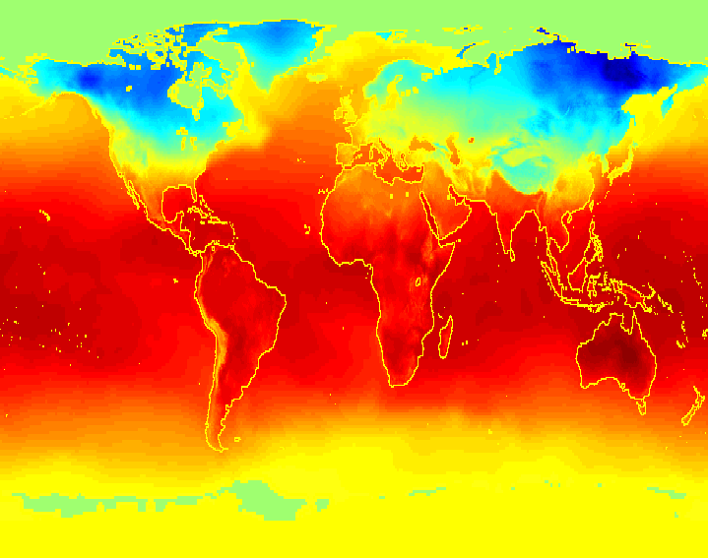
Why Mine Data? Scientific Viewpoint
Data collected and stored at enormous speeds (GB/hour)
remote sensors on a satellite
telescopes scanning the skies
microarrays generating gene expression data
scientific simulations generating terabytes of data
Traditional techniques infeasible for raw data
Data mining may help scientists
in classifying and segmenting data
in Hypothesis Formation

Slide 4
What Is Data Mining?
Data mining (knowledge discovery in databases):
Extraction of interesting (non-trivial, implicit, previously unknown and potentially useful) information or patterns from data in large databases
The efficient discovery of previously unknown, valid, potentially useful, understandable patterns in large datasets
The analysis of (often large) observational data sets to find unsuspected relationships and to summarize the data in novel ways that are both understandable and useful to the data owner

Slide 5
What Is Data Mining?
Alternative names :
Knowledge discovery(mining) in databases (KDD), knowledge extraction, data/pattern analysis, data archeology, business intelligence, etc.

Slide 6
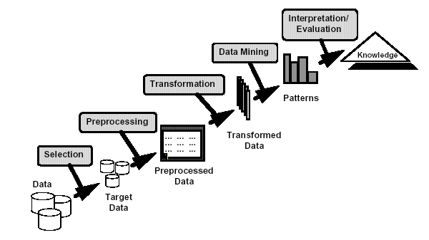
Knowledge Discovery

Slide 7
Examples: What is (not) Data Mining?
What is not Data Mining?
Look up phone number in phone directory
Query a Web search engine for information about “Amazon”
What is Data Mining?
Certain names are more prevalent in certain US locations (O’Brien, O’Rurke, O’Reilly… in Boston area)
Group together similar documents returned by search engine according to their context (e.g. Amazon rainforest, Amazon.com,)

Slide 8
Origins of Data Mining
Draws ideas from machine learning/AI, pattern recognition, statistics, and database systems
Must address:
Enormity of data
High dimensionality of data
Heterogeneous, distributed nature of data
AI /
Machine Learning
Statistics
Data Mining
Database systems

Slide 9
Data Mining: Classification Schemes
Data mining tasks
Descriptive data mining
Predictive data mining
Description Tasks
Find human-interpretable patterns that describe the data.
Prediction Tasks
Use some variables to predict unknown or future values of other variables

Slide 10
Data Mining Tasks
Common data mining tasks
Classification [Predictive]
Clustering [Descriptive]
Association Rule Discovery [Descriptive]
Sequential Pattern Discovery [Descriptive]
Regression [Predictive]
Deviation Detection [Predictive]

Slide 11
How Data Mining is used
1. Identify the problem
2. Use data mining techniques to transform the data into information
3. Act on the information
4. Measure the results

Slide 12
The Data Mining Process
1. Understand the domain
2. Create a dataset:
Select the interesting attributes
Data cleaning and preprocessing
3. Choose the data mining task and the specific algorithm
4. Interpret the results, and possibly return to 2

Slide 13
Terima Kasih
Ada Pertanyaan…???

